Slide 1
Fixed Point Oblivious Amplitude Amplification with QSVT
Sharan Krishnan

Slide 2
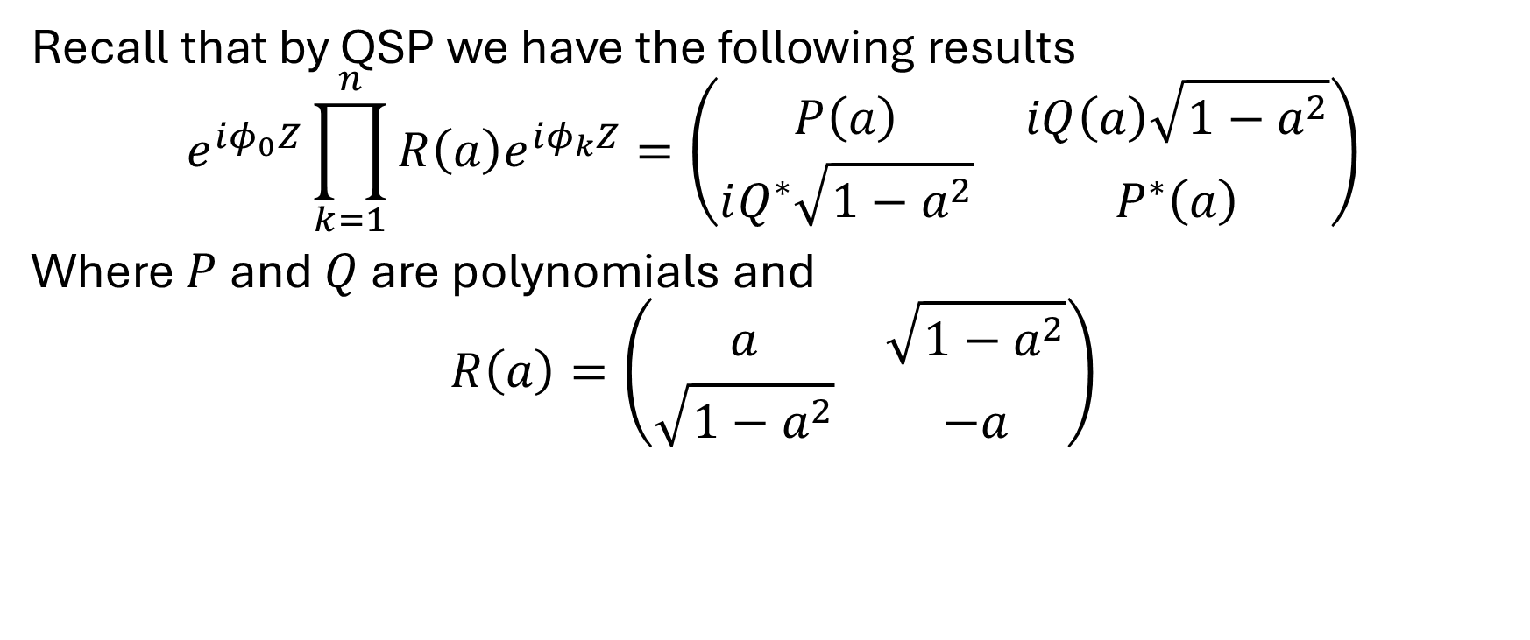
QSVT Recap
Recall that by QSP we have the following results
$$e^{iφ_{0}Z}\prod_{k=1}^{n}{R\left(a\right)e^{iφ_{k}Z}}=\left(\begin{matrix}P\left(a\right) & iQ\left(a\right)\sqrt{1−a^{2}} \\ iQ^{∗}\sqrt{1−a^{2}} & P^{∗}\left(a\right)\end{matrix}\right)$$
Where $P$ and $Q$ are polynomials and
$$R\left(a\right)=\left(\begin{matrix}a & \sqrt{1−a^{2}} \\ \sqrt{1−a^{2}} & −a\end{matrix}\right)$$

Slide 3
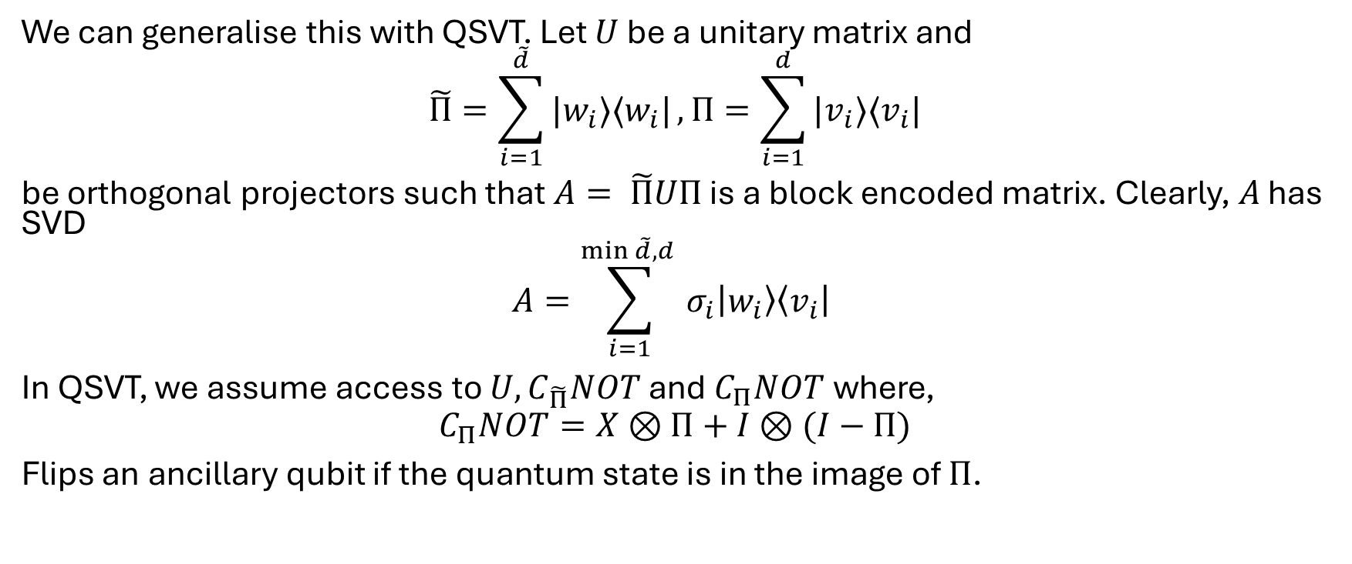
QSVT Recap
We can generalise this with QSVT. Let $U$ be a unitary matrix and
$$\tilde{Π}=\sum_{i=1}^{\tilde{d}}{|w_{i}⟩⟨w_{i}|}, Π=\sum_{i=1}^{d}{|v_{i}⟩⟨v_{i}|}$$
be orthogonal projectors such that $A= \tilde{Π}UΠ$ is a block encoded matrix. Clearly, $A$ has SVD
$$A=\sum_{i=1}^{\min{\tilde{d},d} }{σ_{i}\left|w_{i}\right\rangle \left\langle v_{i}\right|}$$ In QSVT, we assume access to $U, C_{\tilde{Π}}NOT$ and $C_{Π}NOT$ where,
$$C_{Π}NOT=X⊗Π+I⊗(I−Π)$$
Flips an ancillary qubit if the quantum state is in the image of $Π$.

Slide 4
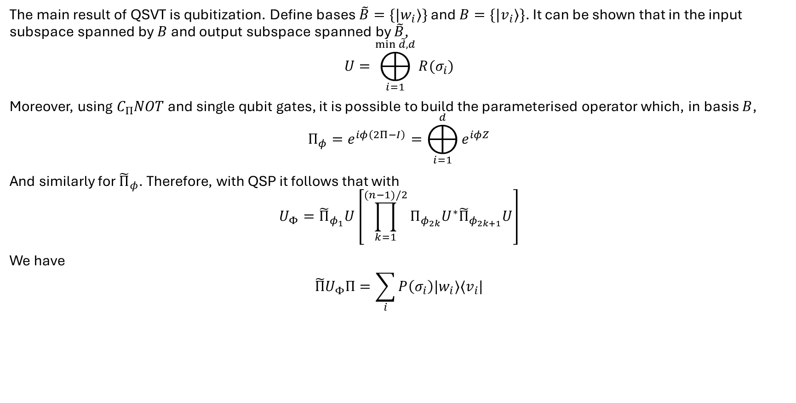
QSVT Recap
The main result of QSVT is qubitization. Define bases $\tilde{B}=\{|w_{i}⟩\}$ and $B=\{|v_{i}⟩\}$. It can be shown that in the input subspace spanned by $B$ and output subspace spanned by $\tilde{B}$,
$$U=⨁_{i=1}^{\min{\tilde{d},d}}{R(σ_{i})}$$
Moreover, using $C_{Π}NOT$ and single qubit gates, it is possible to build the parameterised operator which, in basis $B$,
$$Π_{φ}=e^{iφ\left(2Π−I\right)}=⨁_{i=1}^{d}{e^{iφZ}}$$
And similarly for ${\tilde{Π}}_{φ}$. Therefore, with QSP it follows that with
$$U_{Φ}={\tilde{Π}}_{φ_{1}}U\left[\prod_{k=1}^{(n−1)/2}{Π_{φ_{2k}}U^{∗}{\tilde{Π}}_{φ_{2k+1}}U}\right]$$
We have
$$\tilde{Π}U_{Φ}Π=\sum_{i}{P\left(σ_{i}\right)|w_{i}⟩⟨v_{i}|}$$

Slide 5
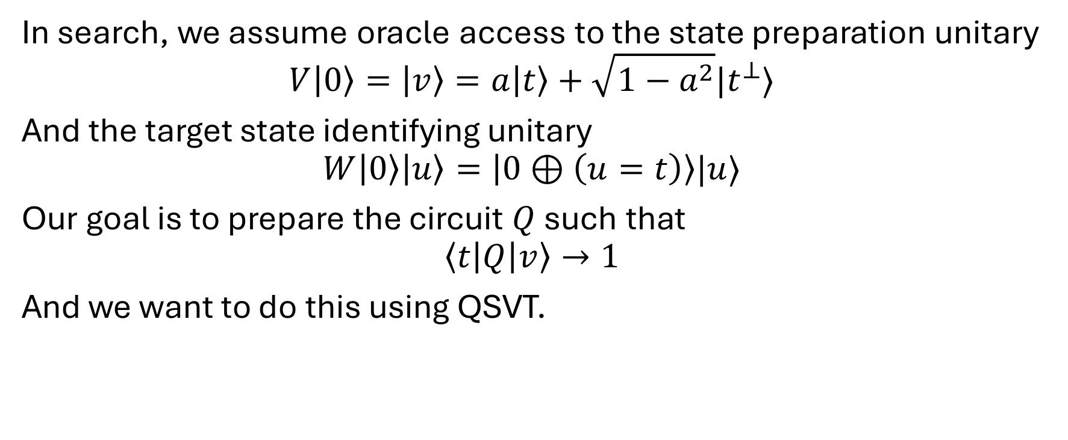
A simple application to search
In search, we assume oracle access to the state preparation unitary
$$V\left|0\right\rangle =\left|v\right\rangle =a\left|t\right\rangle +\sqrt{1−a^{2}}|t^{⊥}⟩$$
And the target state identifying unitary
$$W\left|0\right\rangle \left|u\right\rangle =\left|0⊕\left(u=t\right)\right\rangle |u⟩$$
Our goal is to prepare the circuit $Q$ such that
$$\left\langle t\left|Q\right|v\right\rangle →1$$
And we want to do this using QSVT.

Slide 6
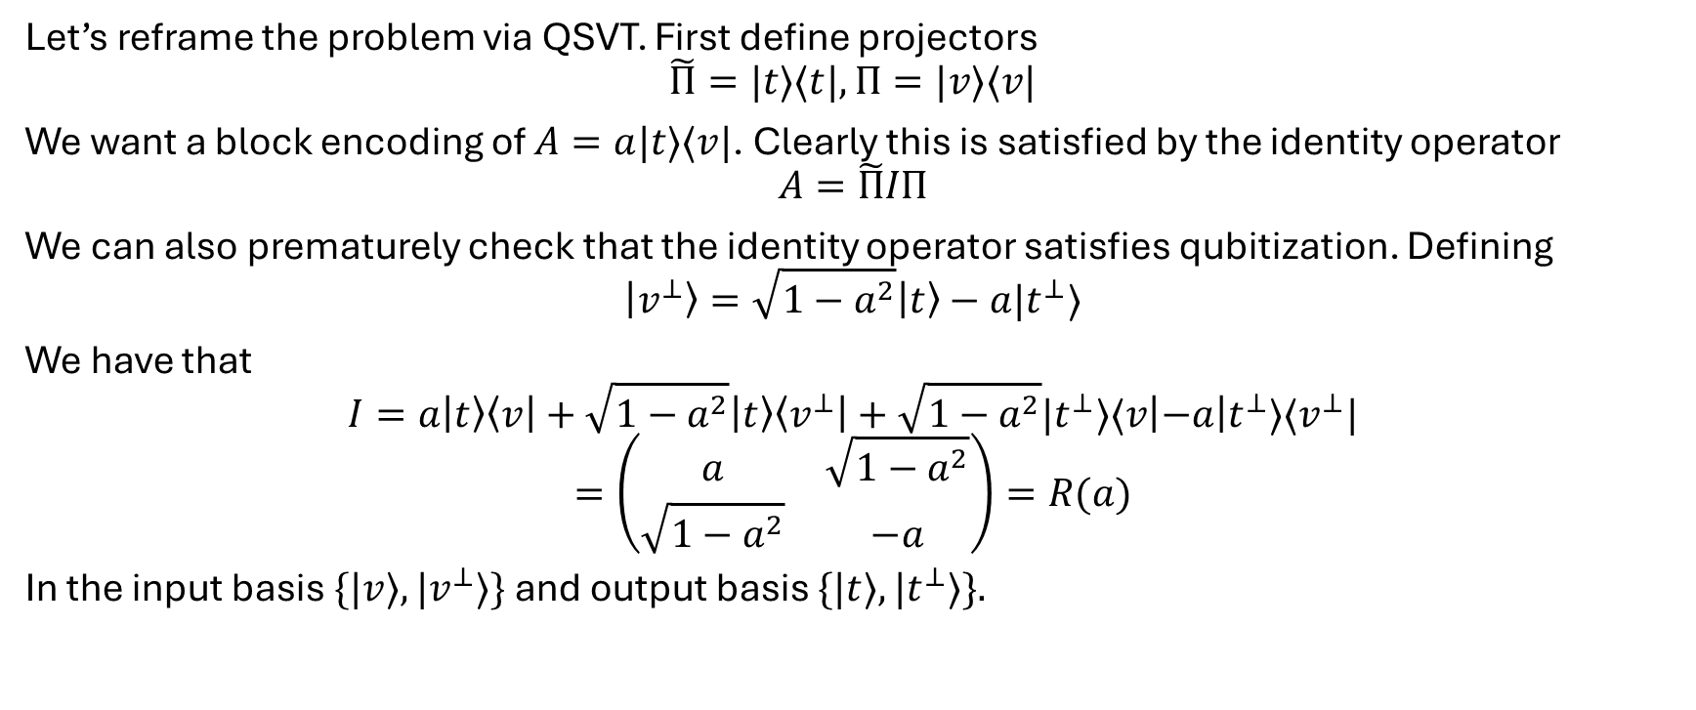
A simple application to search
Let’s reframe the problem via QSVT. First define projectors
$$\tilde{Π}=|t⟩⟨t|, Π=|v⟩⟨v|$$
We want a block encoding of $A=a|t⟩⟨v|$. Clearly this is satisfied by the identity operator
$$A=\tilde{Π}IΠ$$
We can also prematurely check that the identity operator satisfies qubitization. Defining
$$\left|v^{⊥}\right\rangle =\sqrt{1−a^{2}}\left|t\right\rangle −a|t^{⊥}⟩$$
We have that
$$I=a\left|t\right\rangle \left\langle v\right|+\sqrt{1−a^{2}}\left|t\right\rangle \left\langle v^{⊥}\right|+\sqrt{1−a^{2}}|t^{⊥}⟩⟨v\left|−a\right|t^{⊥}⟩⟨v^{⊥}|$$
$$=\left(\begin{matrix}a & \sqrt{1−a^{2}} \\ \sqrt{1−a^{2}} & −a\end{matrix}\right)=R(a)$$
In the input basis $\{|v⟩,|v^{⊥}⟩\}$ and output basis $\{|t⟩,|t^{⊥}⟩\}.$

Slide 7
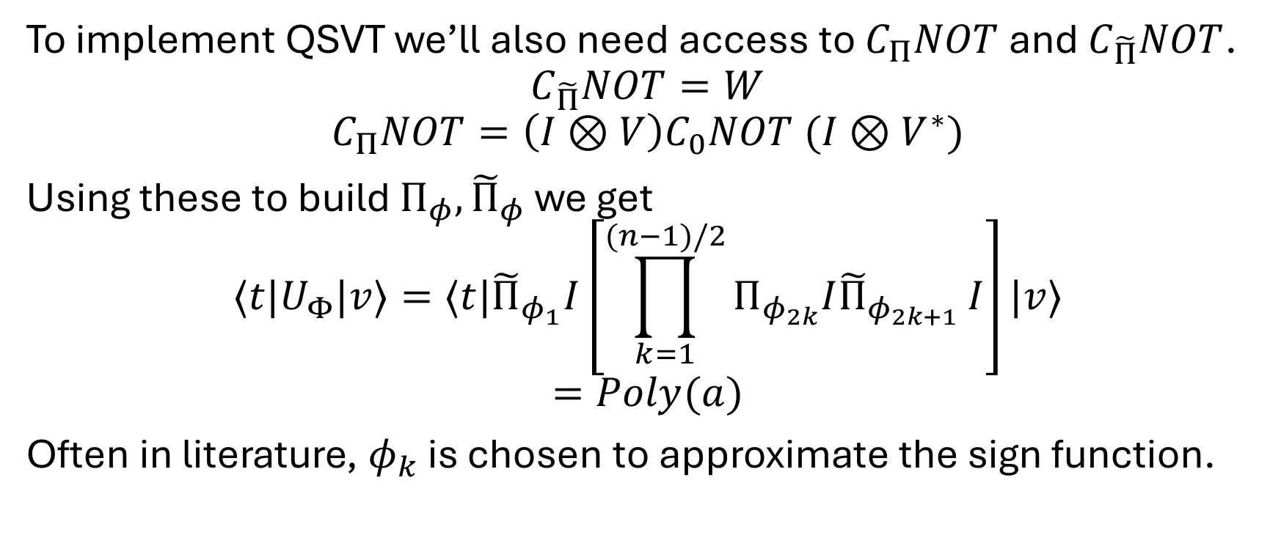
A simple application to search
To implement QSVT we’ll also need access to $C_{Π}NOT$ and $C_{\tilde{Π}}NOT$.
$$C_{\tilde{Π}}NOT=W$$
$$C_{Π}NOT=\left(I⊗V\right)C_{0}NOT (I⊗V^{∗})$$
Using these to build $Π_{φ},{\tilde{Π}}_{φ}$ we get
$${⟨t|U}_{Φ}|v⟩=⟨t|{\tilde{Π}}_{φ_{1}}I\left[\prod_{k=1}^{(n−1)/2}{Π_{φ_{2k}}I{\tilde{Π}}_{φ_{2k+1}}}I\right]|v⟩$$
$$=Poly(a)$$
Often in literature, $φ_{k}$ is chosen to approximate the sign function.

Slide 8

Claim
In the Grand Unification of Quantum Algorithms, the claim is made in the appendices that there exists a phase sequence that transforms a wide range of possible small values of $a$ to be close to 1 with error 1-$δ^{2}$.

Slide 9

$$A⊕B= \begin{matrix}A & 0 \\ 0 & B\end{matrix}$$
$$\left(A⊕B\right)\left(C⊕D\right)=AC⊕BD$$

